Slide 1
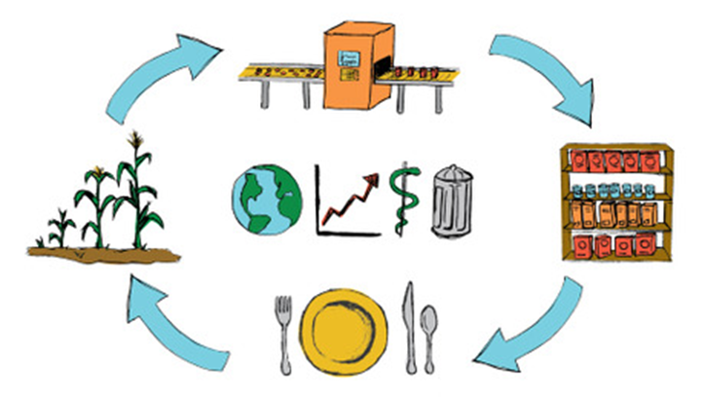
SCIENCE AND TECHNOLOGY IN FOOD PRODUCTION
Chloe brottier
Magali poupard
Isara (p49)

Slide 2
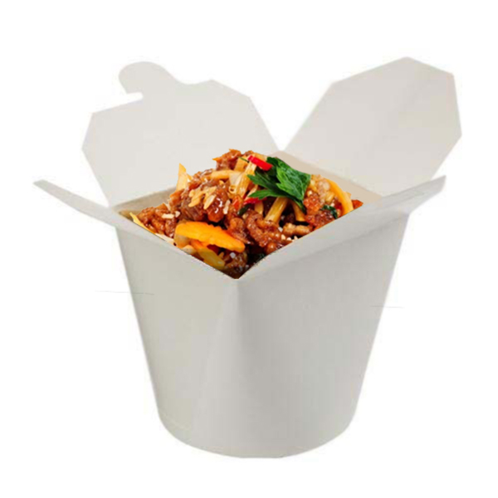
Table of contents
I) Definitions
II) The food supply chain
III) Transformation of raw materials
A) Tomato sauce
B) Meat
C) Pasta
IV) From the industry to consumers
A) Cold chain
B) Packaging
C) Transport and distribution
V) Conclusion

Slide 3
I) Definitions
Food production :
Agriculture :
The science or practice of farming, including cultivation of the soil for the growing of crops and the rearing of animals to provide food, wool, and other products. (https://en.oxforddictionaries.com/definition/agriculture)
Food processing
The transformation of raw ingredients, by physical or chemical means into food. Food processing combines raw food ingredients to produce marketable food products. (https://en.wikipedia.org/wiki/Food_processing)

Slide 4
I) Definitions
Science :
The intellectual and practical activity encompassing the systematic study of the structure and behavior of the physical and natural world through observation and experiment. (https://en.oxforddictionaries.com/definition/science )
Technology :
The application of scientific knowledge for practical purposes, especially in industry. (https://en.oxforddictionaries.com/definition/technology)

Slide 5
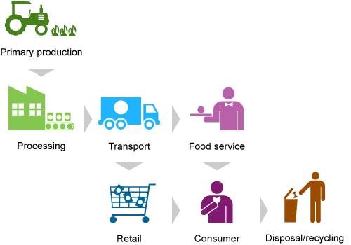

II) The food supply chain

Slide 6
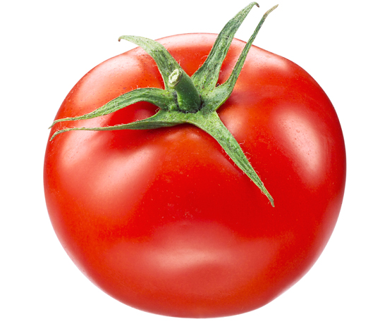
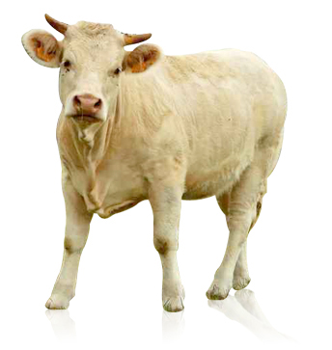
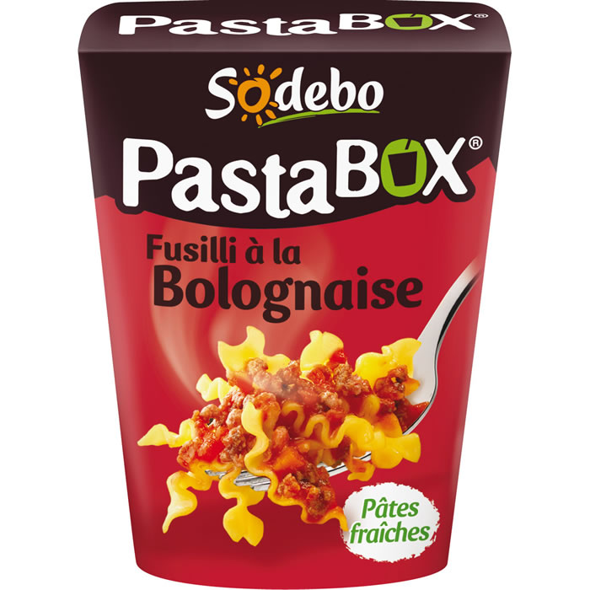
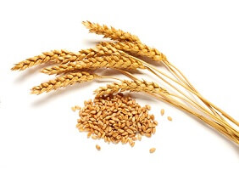
III) From raw materials to finished product
Raw materials :
tomatoes, beef, wheat
Finished product :
Pasta Bolognese box
Manufacturing
https://fr.wikipedia.org/wiki/aliments#/media/File:HF_in_der_Rh%C3%B6n_auf_der_Weide.jpg
https://www.auchandirect.fr/produits/56383

Slide 7
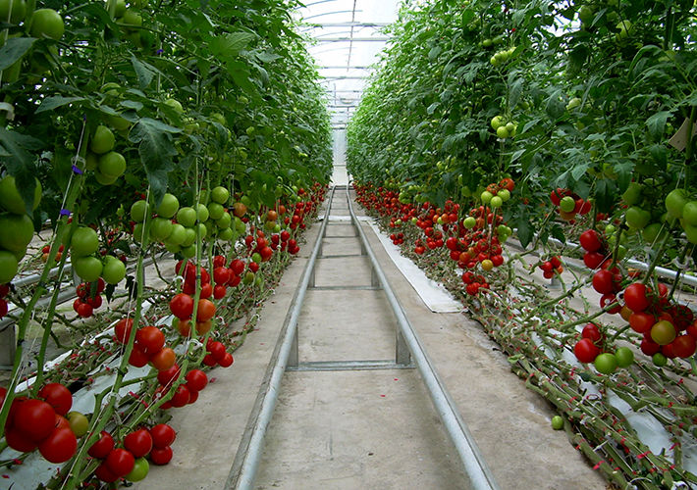
A) Tomatoes
Tomatoes come from greenhouses
Utilisation of fertilizer
Better yield → quicker
A greenhouse
http://www.hortidaily.com/article/12224/Ukraine-Historic-maximum-price-of-greenhouse-tomato

Slide 8
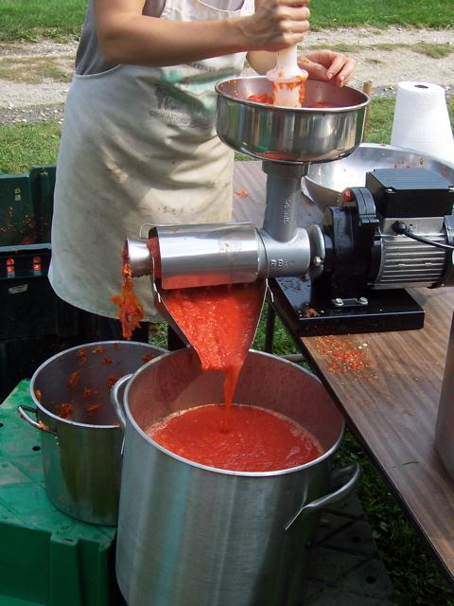
A) Tomatoes transformation
Sort, wash and chop the tomatoes
Put the mixture into pulping machines
Cook for 30-45 minutes
Add vinegar, salt, flavourings and spices
Use a starch-based thickener (viscosity)

Slide 9
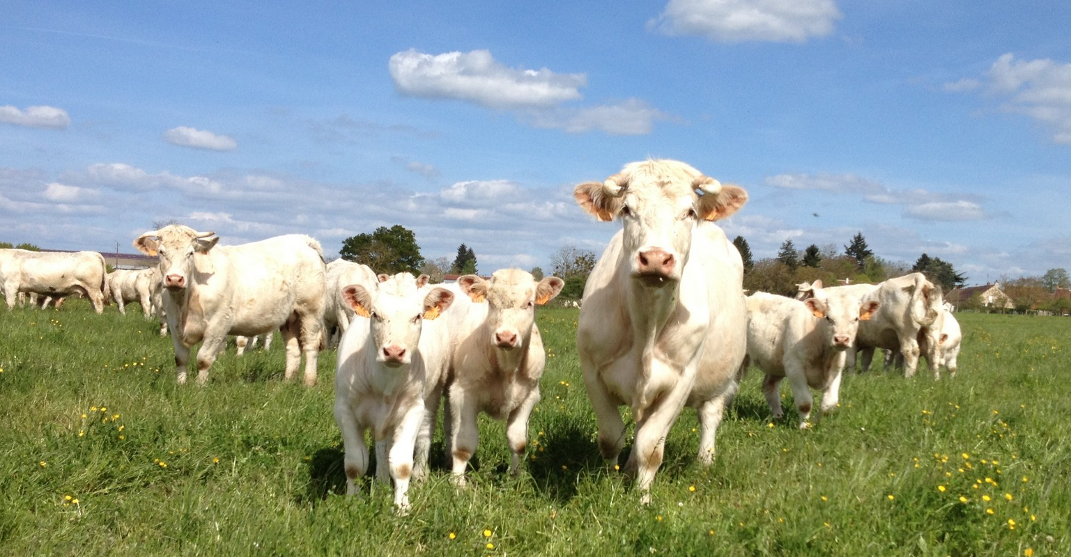

B) Meat
Bolognese => Beef meat
France : First European producer (1 323 000 TEC in 2015)
3 main breeds : Charolaise, Sallers, Limousine
Steps from the prairie to the plate :
https://charolaise.fr/la-charolaise/les-atouts-de-la-race-charolaise/
BREEDING
SLAUGHTER
PREPARATION
TRANSFORMATION

Slide 10
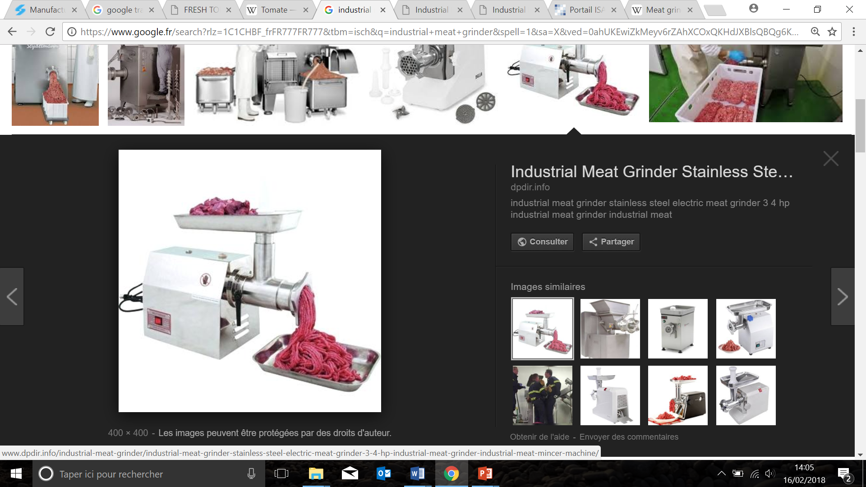
B) Meat transformation
Bolognese → Gound meat → Meat grinder
Meat cooking requirements
Microbiological quality
Organoleptic quality
Nutritional value
SNRC => 65°C but tough and dry
http://www.dpdir.info/industrial-meat-grinder/industrial-meat-grinder-stainless-steel-electric-meat-grinder-3-4-hp-industrial-meat-grinder-industrial-meat-mincer-machine/

Slide 11
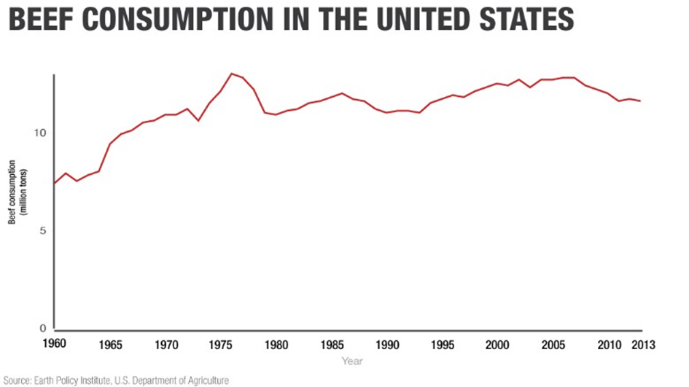
B) Beef consumption

Slide 12
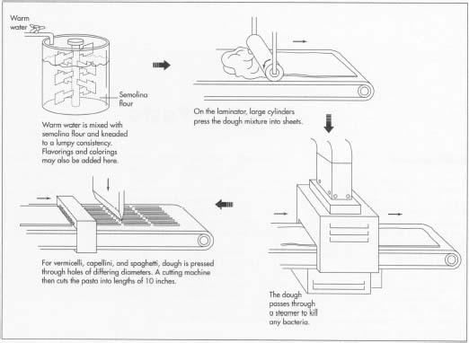
C) Pasta making (from wheat to pasta)
Durum wheat grind into semolina flour
1 : Flour + warm water
2 : Mixture → sheet
3 : The pasta is placed into holes
4 : Dried at a high temperature
2
1
3
4

Slide 13
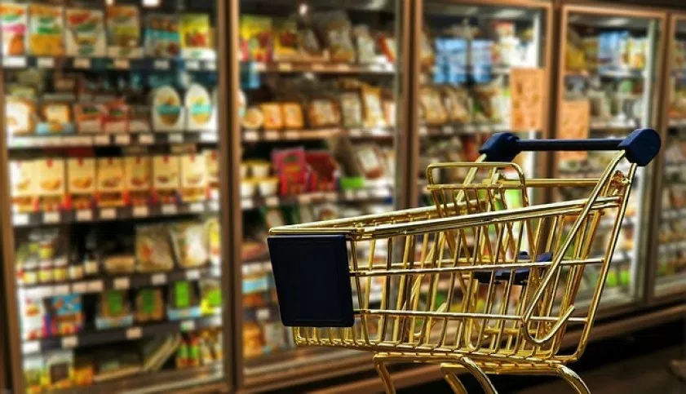
IV) From the industry to consumers
http://revedeliberte.com/blog/societe-de-consommation/

Slide 14
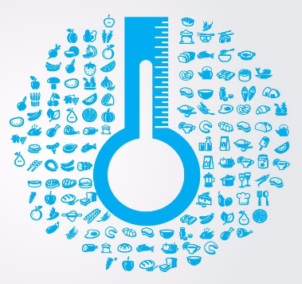
A) Cold Chain
A temperature-controlled supply chain
+2 °C to +8 °C for fresh food products
To preserve and to ensure the shelf life
UNBROKEN ⚠ → uninterrupted series of refrigerated areas
X food poisonning (harmful bacteria) X

Slide 15
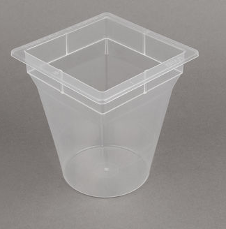
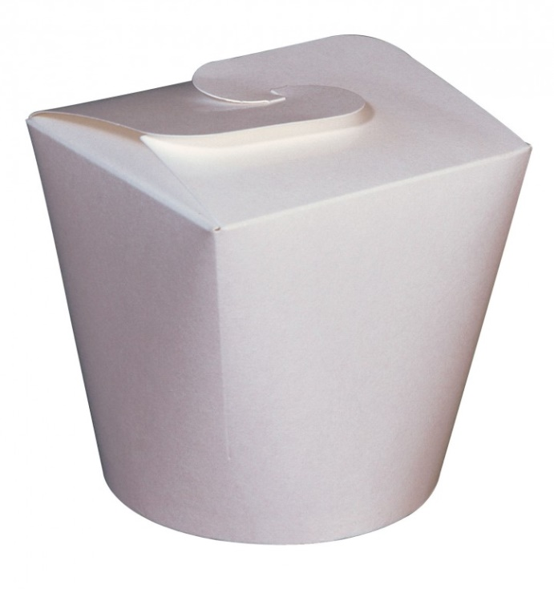
B) Packaging
Packaging :
to use materials to wrap the product
Plastic box :
The steam cook the pasta
Carton box:
Protect the product
Easy transport
A fork can be added by compagnies
https://www.usinenouvelle.com/expo/pla-1061-pasta-box-560-ml-p301496.html
http://www.one-emballage.com/media/resizedimages/

Slide 16
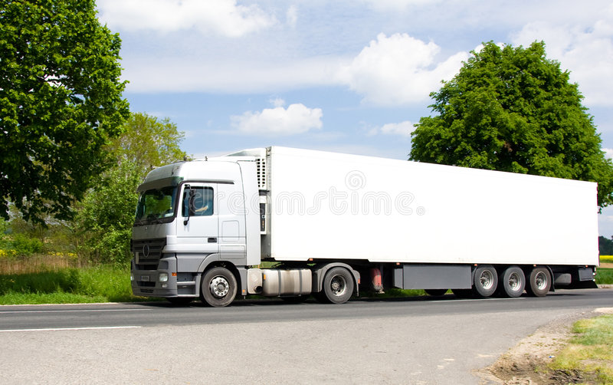
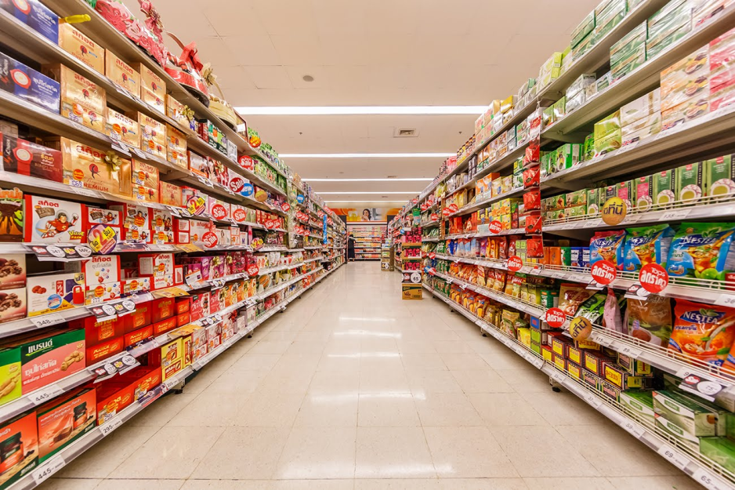
C) Transport and distribution
Transport truck → supermarket

Slide 17

V) Conclusion
Responsability of each actors :
Hygien and quality controls (cold chain)
Improve the quantity and the quality
Innovate to satisfy the request

Slide 18
Bibliographie
http://www.madehow.com/Volume-2/Ketchup.html
http://www.silverson.com/us/resource-library/application-reports/manufacture-of-tomato-sauces-and-ketchups/
https://www.google.fr/search?q=pasta+process&rlz=1C1AVNE_enFR716FR723&source=lnms&tbm=isch&sa=X&ved=0ahUKEwjQ0enfp7TZAhVCbRQKHWVqA0sQ_AUICigB&biw=1366&bih=662#imgrc=HscuHsv9Sdiz_M
https://en.oxforddictionaries.com/definition/agriculture
https://en.wikipedia.org/wiki/Food_processing
https://en.oxforddictionaries.com/definition/science
https://en.oxforddictionaries.com/definition/technology
https://www.viandesetproduitscarnes.fr/index.php?option=com_content&view=article&id=146:cuisson-industrielle-des-viandes-vol-27-6&catid=89&Itemid=466&lang=fr

Slide 19
Thank you for your attention !
Do you have any questions ?

